Slide 1
COMP 3500 Introduction to Operating Systems File Management
Dr. Xiao Qin
Auburn University http://www.eng.auburn.edu/~xqin
xqin@auburn.edu
Notes:
15 Minutes. Slides 1-12.

Slide 2
The External View of the File Manager
Application
Program
mount()
write()
CreateFile()
WriteFile()
close()
open()
CloseHandle()
ReadFile()
lseek()
read()
SetFilePointer()
File Mgr
Device Mgr
Memory Mgr
File Mgr
Device Mgr
Process Mgr
Memory Mgr
Process Mgr
UNIX
Windows
Hardware

Slide 3
Exercise 1 (Plickers). File Management
File is a named, ordered collection of information
A file manager has the following responsibilities except
(A) Storing the information on a device
(B) Mapping the block storage to a logical view
(C) Allocating/deallocating storage and Providing file directories
(D) Handle hard drives in a uniform manner
Notes:
What abstraction should be presented to programmer?

Slide 4
Structure Terms
Four terms are commonly used when discussing files:
Field
Record
File
Database
Notes:
Four terms are in common use when discussing files:
• Field
• Record
• File
• Database
A field is the basic element of data. An individual field contains a single value,
such as an employee’s last name, a date, or the value of a sensor reading. It is characterized
by its length and data type (e.g., ASCII string, decimal). Depending on the
file design, fields may be fixed length or variable length. In the latter case, the field
often consists of two or three subfields: the actual value to be stored, the name of
the field, and, in some cases, the length of the field. In other cases of variable-length
fields, the length of the field is indicated by the use of special demarcation symbols
between fields.
A record is a collection of related fields that can be treated as a unit by some
application program. For example, an employee record would contain such fields
as name, social security number, job classification, date of hire, and so on. Again,
depending on design, records may be of fixed length or variable length. A record
will be of variable length if some of its fields are of variable length or if the number
of fields may vary. In the latter case, each field is usually accompanied by a field
name. In either case, the entire record usually includes a length field.
A file is a collection of similar records. The file is treated as a single entity by
users and applications and may be referenced by name. Files have file names and
may be created and deleted. Access control restrictions usually apply at the file
level. That is, in a shared system, users and programs are granted or denied access
to entire files. In some more sophisticated systems, such controls are enforced at the
record or even the field level.
Some file systems are structured only in terms of fields, not records. In that
case, a file is a collection of fields.
A database is a collection of related data. The essential aspects of a database
are that the relationships that exist among elements of data are explicit and that the
database is designed for use by a number of different applications. A database may
contain all of the information related to an organization or project, such as a business
or a scientific study. The database itself consists of one or more types of files. Usually,
there is a separate database management system that is independent of the operating
system, although that system may make use of some file management programs.

Slide 5
Information Structure
Applications
Records
Structured Record Files
Record-Stream Translation
Byte Stream Files
Stream-Block Translation
Storage device
Notes:
From the user’s point of view, one of the most important parts of an operating
system is the file system. The file system provides the resource abstractions typically
associated with secondary storage. The file system permits users to create data
collections, called files, with desirable properties, such as:
• Long-term existence: Files are stored on disk or other secondary storage and
do not disappear when a user logs off.
• Sharable between processes: Files have names and can have associated access
permissions that permit controlled sharing.
• Structure: Depending on the file system, a file can have an internal structure
that is convenient for particular applications. In addition, files can be organized
into hierarchical or more complex structure to reflect the relationships
among files.

Slide 6
Exercise 2 (Plickers). Which one of the following byte stream file interface is ill-designed? e.g., backingstore in project 5
(A) fileID = open(fileName)
(B) read(fileID, buffer, length)
(C) write(fileName, buffer, length)
(D) seek(fileID, filePosition)
close(fileID)

Slide 7
Low Level Files
fid = open(“fileName”,…);
…
read(fid, buf, buflen);
…
close(fid);
...
...
b₀
b₁
b₂
b_{i}
int open(…) {…}
int close(…) {…}
int read(…) {…}
int write(…) {…}
int seek(…) {…}
Stream-Block Translation
Storage device response to commands

Slide 8
Structured Files
Records
Record-Block Translation

Slide 9
Exercise 3 (Plickers). Which one of the following record-oriented sequential files interface is ill-designed?
Logical Record
(A) fileID = open(fileName)
(B) getRecord(fileID, record, length)
(C) putRecord(fileID, record)
(D) seek(fileID, position)
close(fileID)

Slide 10
File Operations
File is an abstract data type
Create
Write
Read
Reposition within file
Delete
Truncate
Open(F_{i}) – search the directory structure on disk for entry F_{i}, and move the content of entry to memory
Close (F_{i}) – move the content of entry F_{i} in memory to directory structure on disk
Notes:
Ask a question.

Slide 11
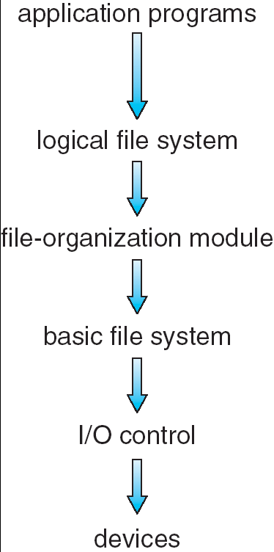
Exercise 4 (Plickers): Secondary storage device contains the following items except?
(A) Volume directory (sometimes a root directory for a file system)
(B) Process ID or PID
(C) External file descriptor for each file
(D)The file contents
Notes:
Give an example of my senior design project. Real-time disk scheduling.
Illustrate why file systems must be organized into layers

Slide 12
Implementing Low Level Files
Manages blocks
Assigns blocks to files (descriptor keeps track)
Keeps track of available blocks
Maps to/from byte stream
Notes:
Give an example of my senior design project. Real-time disk scheduling.
Illustrate why file systems must be organized into layers

Slide 13
File Descriptors
External name
Current state
Sharable
Owner
User
Locks
Protection settings
Length
Time of creation
Time of last modification
Time of last access
Reference count
Storage device details
How to design a file control block (a.k.a., file descriptor)?
From “File Systems Requirements” to “File Attributes”
From “File Attributes” to “a File Control Block”
Notes:
Reference: http://pages.cs.wisc.edu/~bart/537/lecturenotes/figures/demos-fs.gif

Slide 14
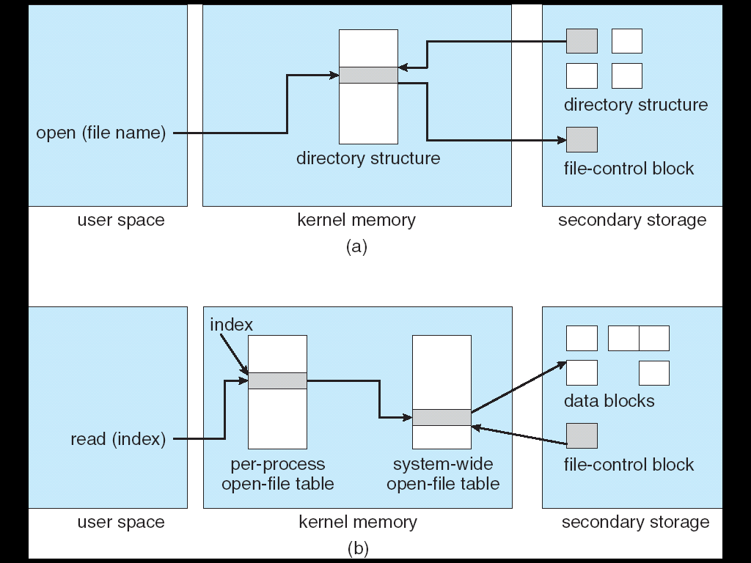
In-Memory File System Structures

Slide 15
An open() Operation
Locate the on-device (external) file descriptor
Extract info needed to read/write file
Authenticate that process can access the file
Create an internal file descriptor in primary memory (“System-wide”)
Create an entry in a “per process” open file status table
Allocate resources, e.g., buffers, to support file usage

Slide 16
File Manager Data Structures
2
Keep the state of the process-file session
1
Copy info from external to the open file descriptor
Open File
Descriptor
3
Return a reference to the data structure
Process-File
Session
External File Descriptor

Slide 17
Summary
Low Level Files
File Descriptors
In-Memory File System Structures
An open() Operation

Slide 18
COMP 3500 Introduction to Operating Systems Directory Structures
Block Management
Dr. Xiao Qin
Auburn University http://www.eng.auburn.edu/~xqin
xqin@auburn.edu
Notes:
25 Minutes.
Focus on the idea of LRU.
Clock policy was not covered.

Slide 19
Virtual File Systems
Virtual File Systems (VFS) provide an object-oriented way of implementing file systems.
VFS allows the same system call interface (the API) to be used for different types of file systems.
The API is to the VFS interface, rather than any specific type of file system.

Slide 20
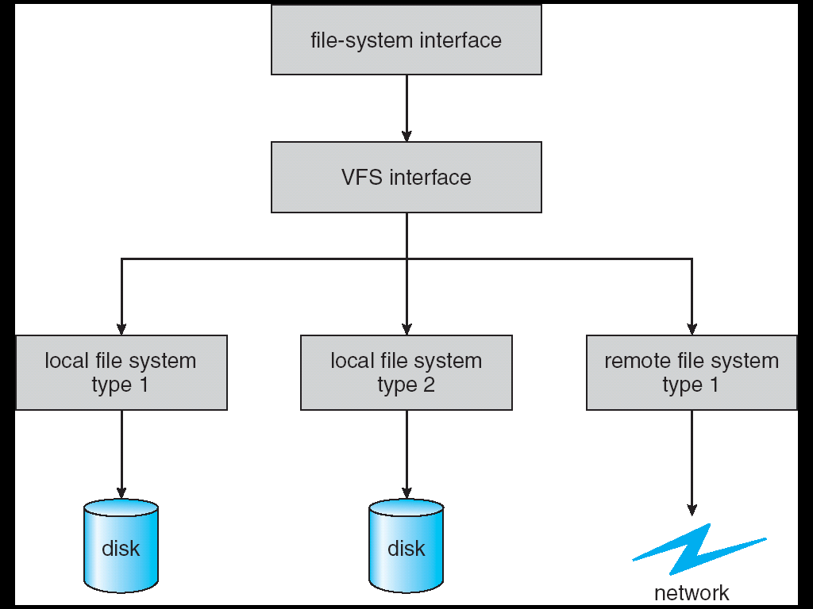
Schematic View of a Virtual File System

Slide 21
Directory Structure
A collection of nodes containing information about all files
Directory
Files
F 1
F 2
F 3
F 4
F n
Both the directory structure and the files reside on disk
Backups of these two structures are kept on storage systems

Slide 22
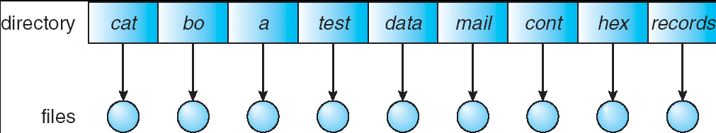
Exercise 5 (Plickers): Single-Level Directory
A single directory for all users
What is a problem with the single-level directory?
Difficult to implement
Difficult to search the directory
Naming and grouping problem
Overhead is high

Slide 23
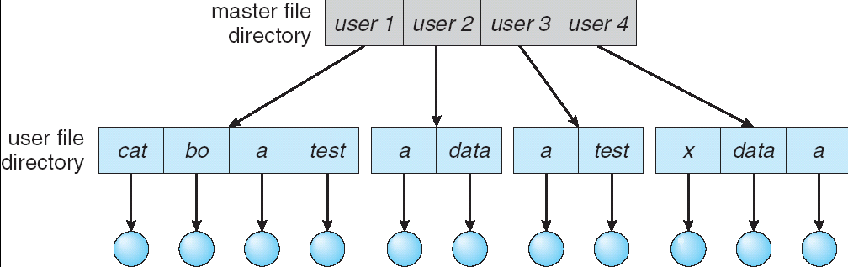
Two-Level Directory
Separate directory for each user
Advantages? Problems?
Path name
Can have the same file name for different user
Efficient searching
No grouping capability

Slide 24
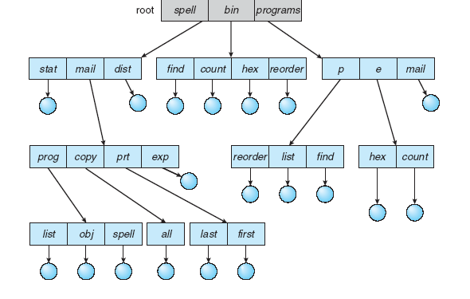
Tree-Structured Directories
Notes:
Efficient searching
Grouping Capability
Current directory (working directory)
cd /spell/mail/prog
type list

Slide 25
Block Management
The job of selecting & assigning storage blocks to the file
For a fixed sized file of k blocks
File of length m requires N = ⎡m/k⎤ blocks
Byte b_{i} is stored in block ⎣i/k⎦
Three basic strategies:
Contiguous allocation
Linked lists
Indexed allocation

Slide 26
Contiguous Allocation
Maps the N blocks into N contiguous blocks on the secondary storage device
Difficult to support dynamic file sizes
File descriptor
Head position 237
…
First block 785
Number of blocks 25

Slide 27
Exercise 6 (Plickers): Which statement about linked lists is incorrect?
Each block contains a header with
Number of bytes in the block
Pointer to next block
Blocks need not be contiguous
Files can expand and contract
Seeks can be fast
First block
…
Head: 417
...
Length
Length
Length
Byte 0
Byte 0
Byte 0
...
...
...
Byte 4095
Byte 4095
Byte 4095
Block 0
Block 1
Block N-1

Slide 28
Indexed Allocation
Extract headers and put them in an index
Simplify seeks
May link indices together (for large files)
Byte 0
...
Index block
…
Head: 417
...
Byte 4095
Length
Block 0
Byte 0
Length
...
Byte 4095
Byte 0
Block 1
...
Length
Byte 4095
Block N-1

Slide 29
inode
UNIX Files
mode
owner
…
Direct block 0
Direct block 1
…
Direct block 11
Single indirect
Double indirect
Triple indirect
Data
Data
Data
Index
Data
Index
Data
Index
Index
Index
Data
Index
Data
Index
Index
Data
Index
Data

Slide 30
Unallocated Blocks
How should unallocated blocks be managed?
Need a data structure to keep track of them
Linked list
Very large
Hard to manage spatial locality
Block status map (“disk map”)
Bit per block
Easy to identify nearby free blocks
Useful for disk recovery

Slide 31
Summary
Directory Structures
Single-Level Directory
Two-Level Directory
Tree-Structured Directory
Block Management
Contiguous Allocation
Linked Lists
Indexed Allocation

